Slide 1
CS Enrichment Project:
Exchange Rate Forecast
(USD to BRL)
Group: Jeremiah, Marlon, Xitlali, Yssie
Date: July 31st, 2024

Slide 2
We have been discussing financial aid packages at Tufts and how conversion rates affect international students in real life.
Since there are many data points available for that, this makes it a convenient project to do using PYMC.

Slide 3
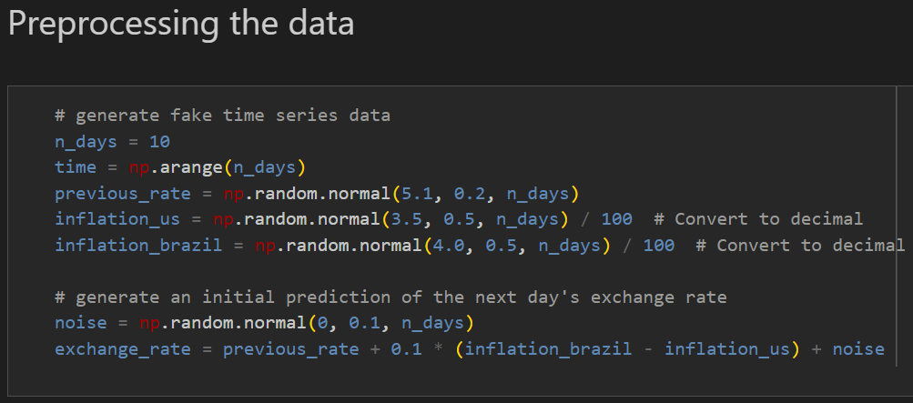

Slide 4
Key assumption: normal distributions

Slide 5
It takes too much time to run, so for now we have 10 days

Slide 6
We have a plot for exchange_rate on the next slide

Slide 7
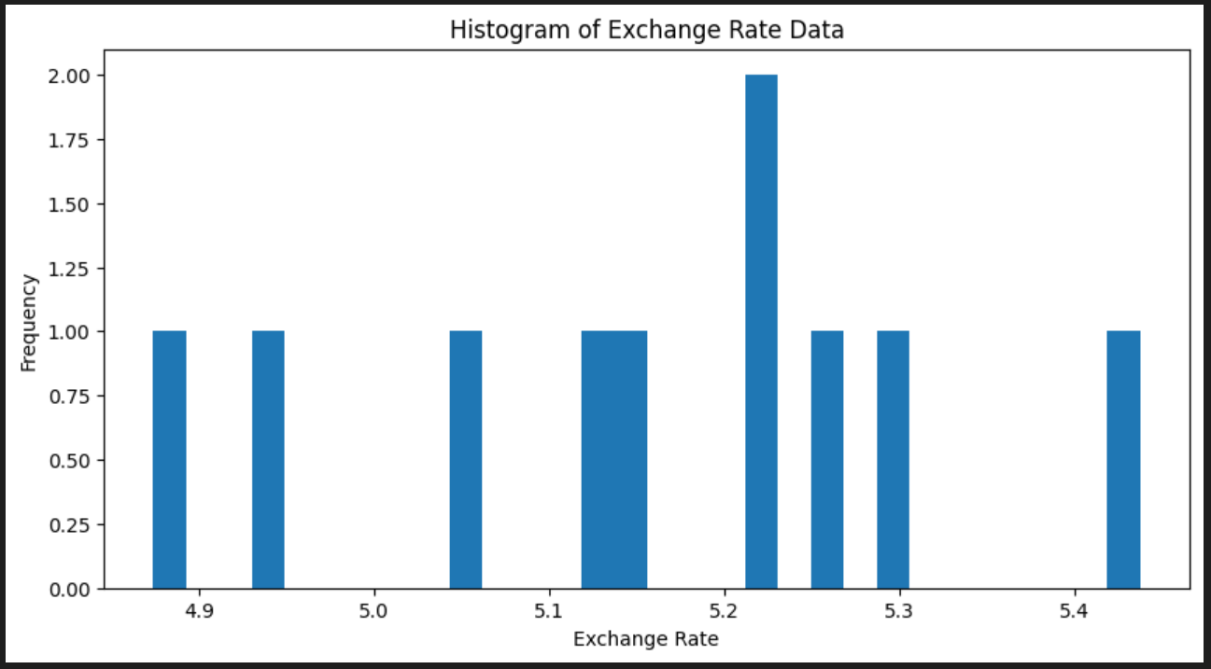

Slide 8
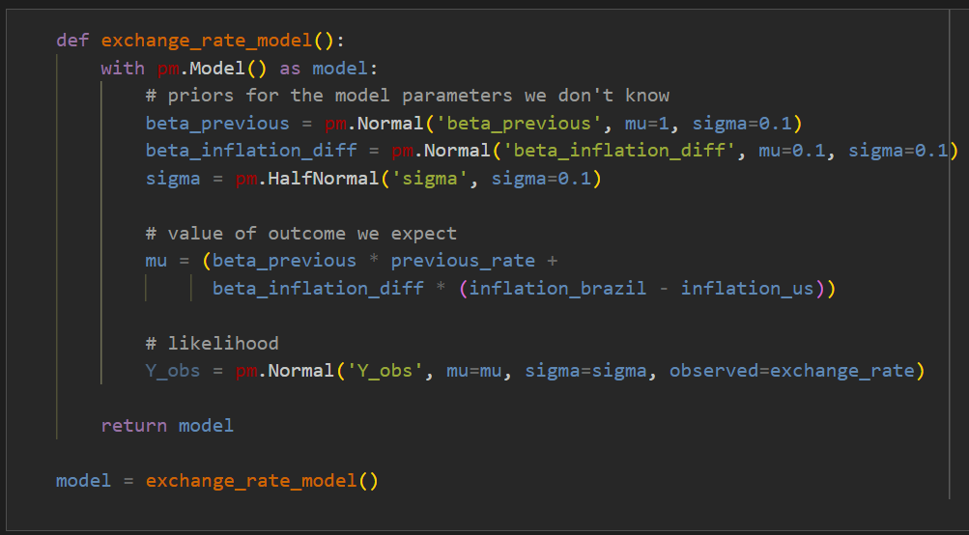

Slide 9
Key assumption: mean of likelihood is a linear function in terms of previous exchange rate and difference between inflation rates

Slide 10
$$μ=β_{previous}∙(previous rate)+β_{\left(inflation difference\right)}∙(inflation difference)$$

Slide 11
Problems: is it really at least reasonably linear? Are those indeed the parameters with biggest influence on the exchange rate? How to properly account for time?

Slide 12
Key assumptions: normal distributions for linear coefficients, and halfnormal distribution (i.e., normal with only positive part) for the sigma parameter (standard deviation)

Slide 13
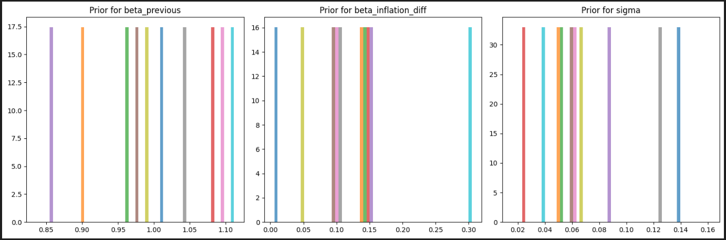

Slide 14
Every time we try to do it with priors that are very distant from reality, we get this error message:
Sampling 4 chains for 1_000 tune and 1_000 draw iterations (4_000 + 4_000 draws total) took 230 seconds.
There were 324 divergences after tuning. Increase target_accept or reparameterize.
The rhat statistic is larger than 1.01 for some parameters. This indicates problems during sampling. See https://arxiv.org/abs/1903.08008 for details
Sampling: [Y_obs]
We are still trying to figure out how to do it without relying on looking on the actual data for the priors, but for now we needed to “cheat” and do that

Slide 15
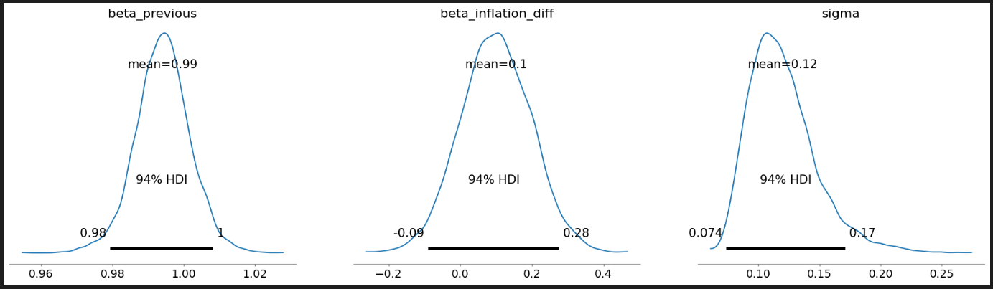
We also used Arviz (a tool in Python to analyze Bayesian models) to analyze our posterior. They changed slightly compared to the priors

Slide 16
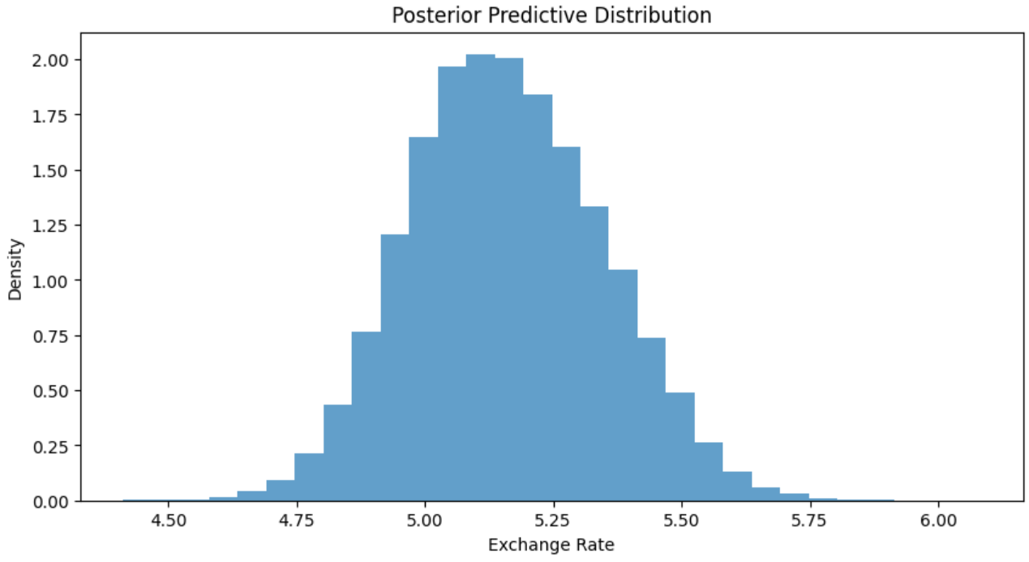
Finally, the heart of our project: the posterior predictive! It changed a little bit compared to the prior

